Slide 1
Personal Software ProcessSM
for Engineers: Part II
Software Design I

Slide 2
Lecture Topics
The design framework
Design completeness
Design representation
The PSP design templates
  operational specification
  functional specification
  state specification
  logic specification
The design hierarchy

Slide 3
Design is a Learning Process
Design involves discovery, invention, and intuitive leaps from one abstraction level to another.
While the design must reflect the requirements, requirements usually are not stable until the product has been used, if then.
Design work is iterative, and it must be driven by feedback from all involved parties.
The critical problem is knowing when to freeze the design to produce the next iteration.

Slide 4
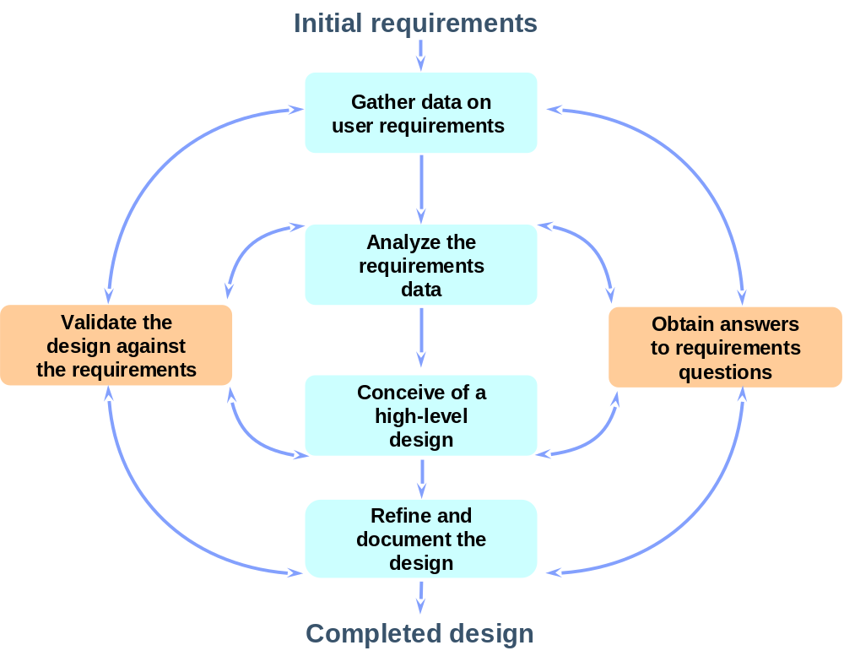
The Design Framework

Slide 5
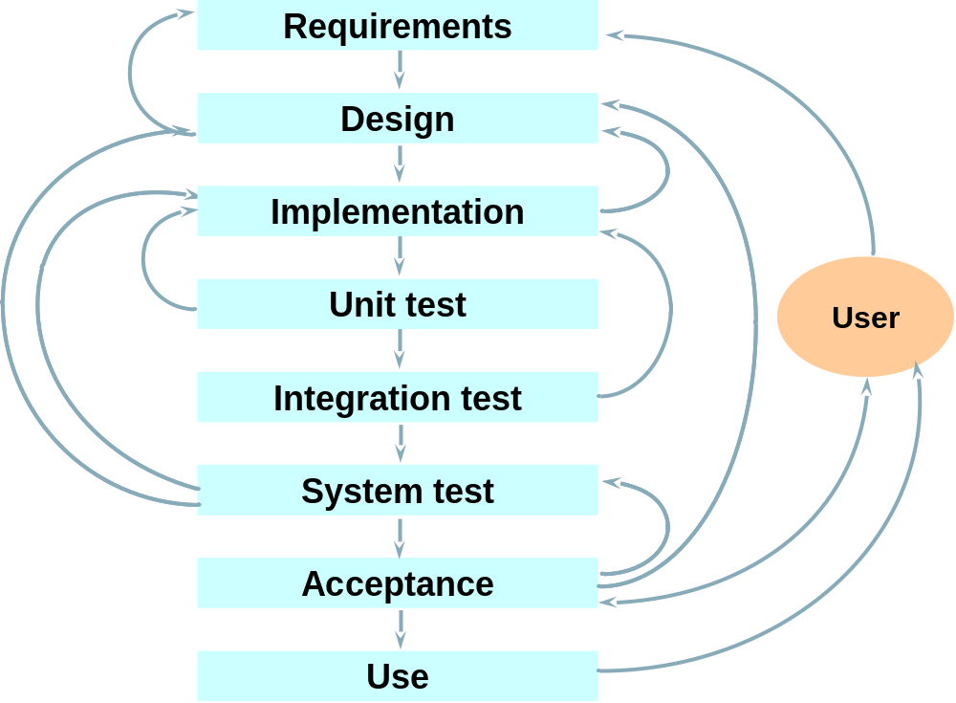
Development Framework

Slide 6
Design Quality
Design is a defect prevention activity.
Poor quality designs are a major source of rework, maintenance, and user dissatisfaction.
A quality design
  is complete and precise
  meets the user’s needs
  precisely guides implementation

Slide 7
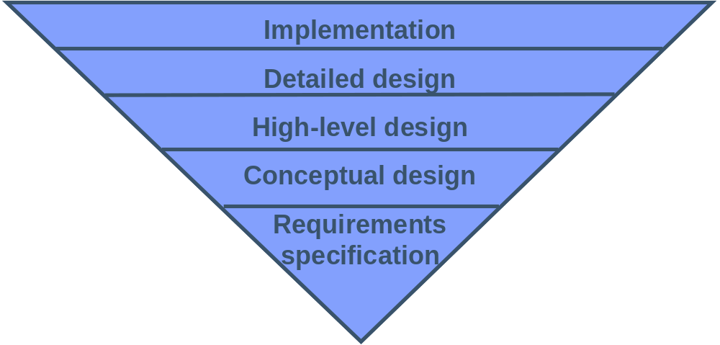
Design Levels
Design work is an inverted pyramid in which each level
  provides a foundation for the following levels
  debugs the preceding levels
To save time and prevent defects, document all design decisions at all levels when they are made.

Slide 8
Structuring the Design Process
Good software designers follow a dynamic process. They
  jump from concept to detail
  simultaneously consider issues at several design levels
  explore multiple alternatives
A structured design process can help you to manage the dynamics of design.
  capture what has been learned
  record and manage issues
  track design status
A properly-implemented design process will reduce rework, manage routine tasks, and give the designer the freedom to be creative.

Slide 9
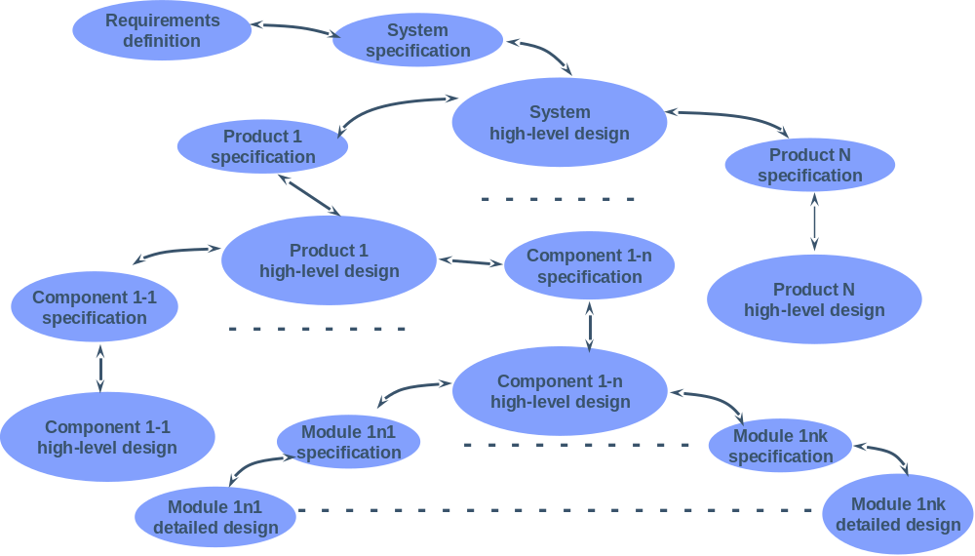
The Design Hierarchy

Slide 10
The PSP Design Process
Since there is no single best design method, the PSP supports multiple methods.
The PSP focuses on what a complete design should contain.
The goal is to eliminate requirements and design defects.
The PSP uses design templates to provide
  criteria for design completeness
  reviewable designs

Slide 11
Design Completeness
Under-specified and incomplete designs are expensive and error-prone.
Designs can be over-specified, especially when they are produced without completeness criteria.
In the PSP course, most students find that their designs are incomplete and do not adequately guide implementation.
To avoid over- or under-specification
  examine your defect data
  establish design completeness criteria
  focus on design quality

Slide 12
Design Representation
It is important to separate two issues.
  how to do the design
  how to represent the design when it is completed
Since the PSP can be used with any design method, it does not specify a specific design approach.
However, the PSP does address design representation.

Slide 13
Design Methods and Notations
There are many design methods.
  None have been proven best for every domain.
  The best method often depends on individual skills and preferences.
  A widely-usable process must work with many different design methods.
There are also many types of design notations.
  Graphics assist in visualizing structure.
  Formality provides precision.
  Text provides intuitive understanding.
  Often all three types of design notations are needed.

Slide 14
Poor Design Notations Cause Defects
Design visibility
  Complex designs are difficult to visualize.
  A poor representation compounds visualization problems.
  A well-represented design captures all design decisions unambiguously.
Design redundancy
  A redundant design is often inconsistent.
  Inconsistency breeds errors and causes defects.
  A quality design has minimum duplication.
  Where possible, use design tools that ensure consistency.

Slide 15
Design Notation Requirements
The design notation must
  precisely define all significant design aspects
  be commonly understood
  communicate the designers’ intent
  help to identify design problems and omissions
  be suitable for representing a broad range of designs
The design should also
  be concise and easy to use
  provide a complete and accessible reference
  have minimum redundancy
Formal notations meet these criteria.

Slide 16
Using Formal Notation
Advantages: using a formal notation
  produces precise and compact designs
  builds familiarity with an important notation
  is consistent with the notation used in formal methods for proving program correctness
  distinguishes logic from other expressions
Disadvantages: formal designs
  generally take more time to create
  take practice to build familiarity
  may not be understood by users and co-workers

Slide 17
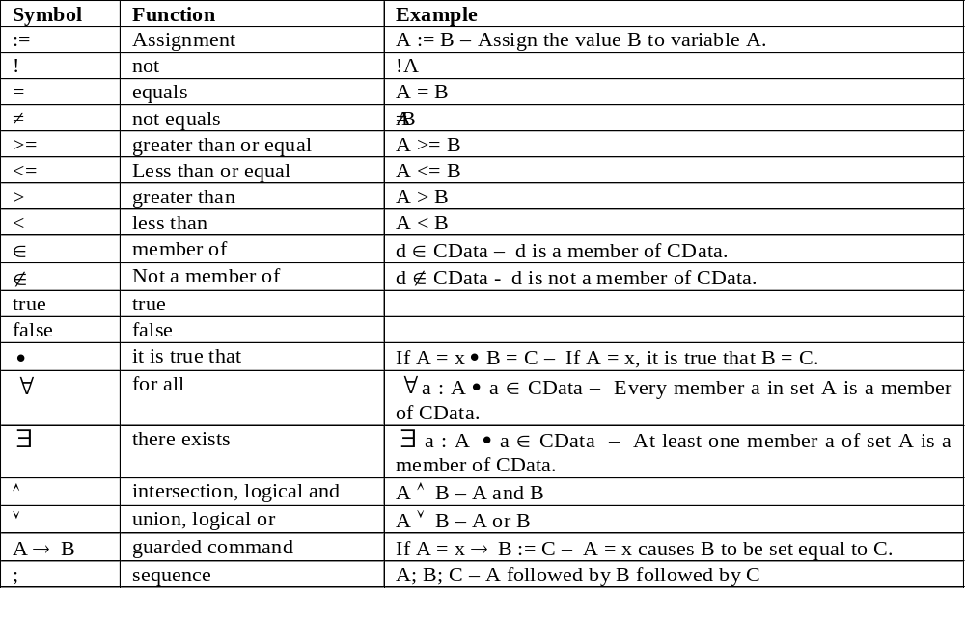
Mathematical Notation

Slide 18
Program Functional Statements
When describing program functions, actions and conditions are separated.
Condition → Action
Read, “When Condition is true, do Action.”
Several condition/action pairs are written as
Condition A → Action A | when Condition A, do Action A
∨ | or
Condition B → Action B | when Condition B, do Action B
∨ | or
Condition C → Action C | when Condition C, do Action C

Slide 19
Notation Examples -1
If x is positive, set y to zero.
x > 0 → y := 0
If x is even, return the sum of x and y, otherwise return the difference between x and y.
even(x) → return( x + y ) ∨ odd(x) → return( x – y )

Slide 20

Notation Examples -2
State that an array a[0..N-1] has no duplicate elements.
This expression reads as follows.
For all indexes i and j with values in the range 0 to N-1, where i and j are not equal, the corresponding elements of the array a are not equal.

Slide 21
Users of Design Information
The principal users of the design are
  implementers
  design reviewers and verifiers
  testers and test developers
  documenters, maintainers, and enhancers
These users potentially need a large amount of material.
  Not all information is needed immediately.
  Some information can be obtained from other sources.
  It is wise to limit the design workload as much as possible.

Slide 22
Essential Design Information
The information that designers should provide includes
  a picture of where the program fits into the system
  a description of how the program will be used
  a specification for all related classes and parts
  a structural view of the product
  a specification of all external calls and references
  a list of all external variables, parameters, and constants
  a clear statement of the program’s logic
The essential design information can be categorized into static or dynamic views, and internal or external views.

Slide 23
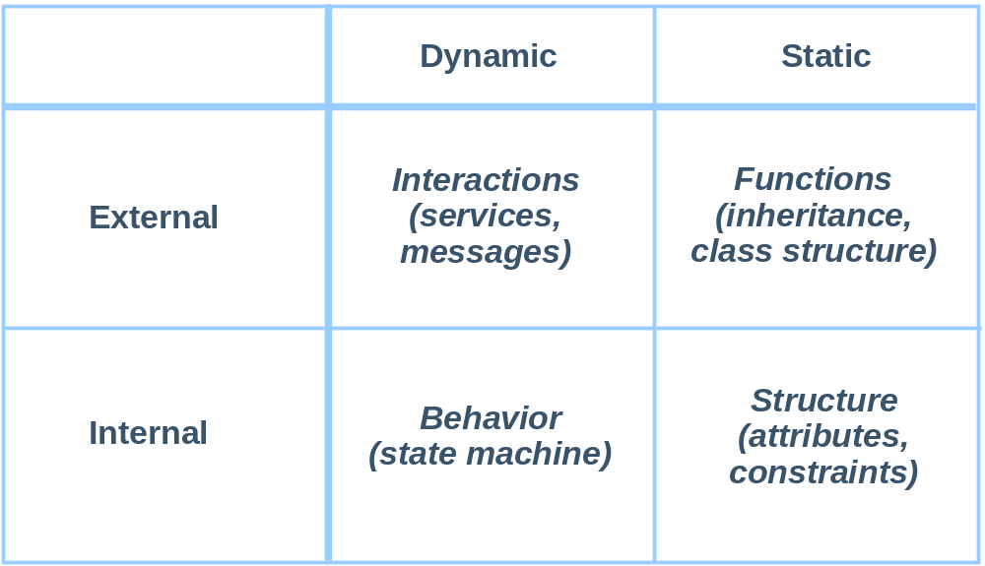
Design Views

Slide 24
Design Templates
Four design templates are used in the PSP to cover the four design views.
  operational specification template
  functional specification template
  state specification template
  logic specification template
These four templates provide the framework for completely and precisely recording a software design.

Slide 25
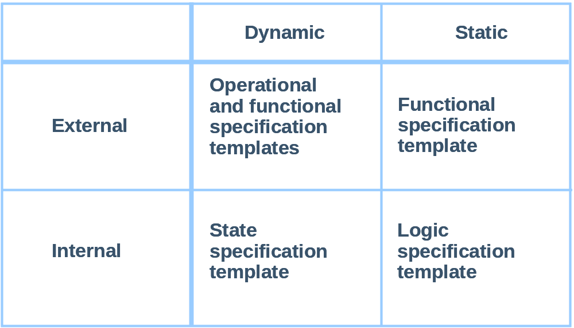
Mapping Templates to Views

Slide 26
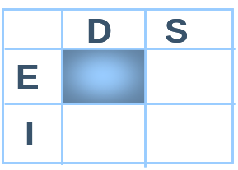
Operational Template
The operational specification template describes the users’ normal and abnormal interactions with the system.
It contains the
  principal user actions and system responses
  anticipated error and recovery conditions
The operational specification template can be used to
  define test scenarios and test cases
  resolve development questions about operational issues
  resolve requirements discussions with users

Slide 27
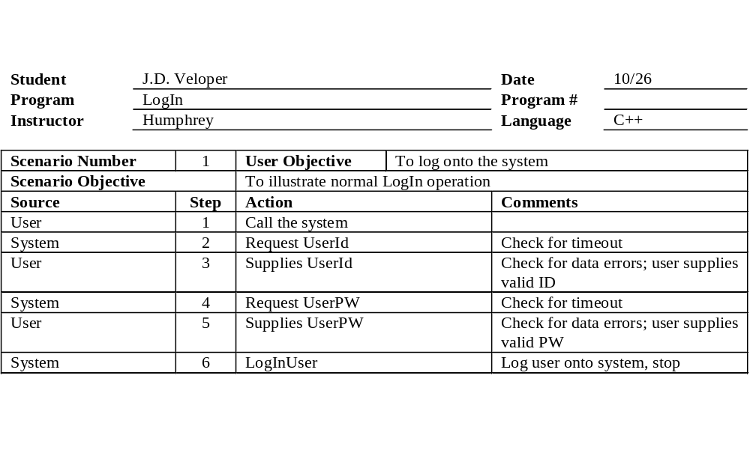
Example Operational Template

Slide 28
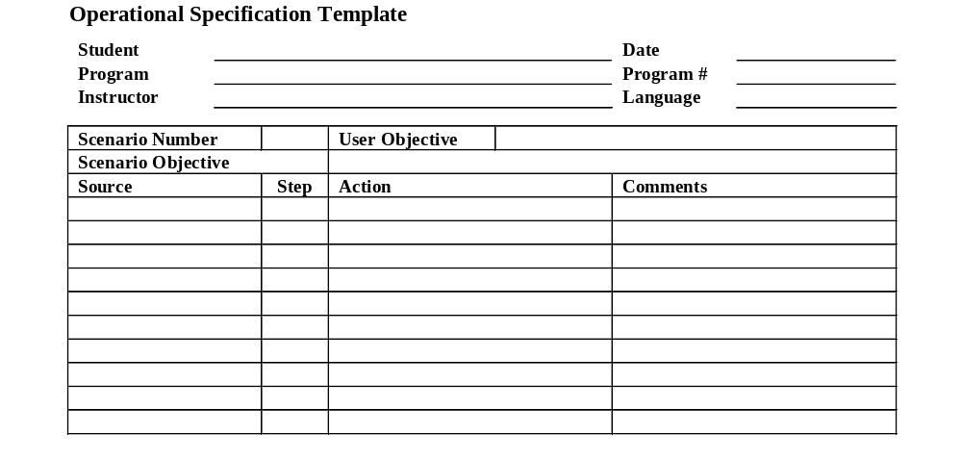
Operational Template Class Exercise -1
For this exercise, as a class, we will produce an operational scenario template for program 5.

Slide 29
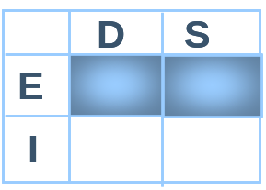
Functional Template
The functional specification template allows you to unambiguously define the external functions provided by the product.
  classes and inheritance
  externally visible attributes
  external functions provided
  relationships with other classes or parts
Where possible, specify the behavior of each function or method with a formal notation.

Slide 30
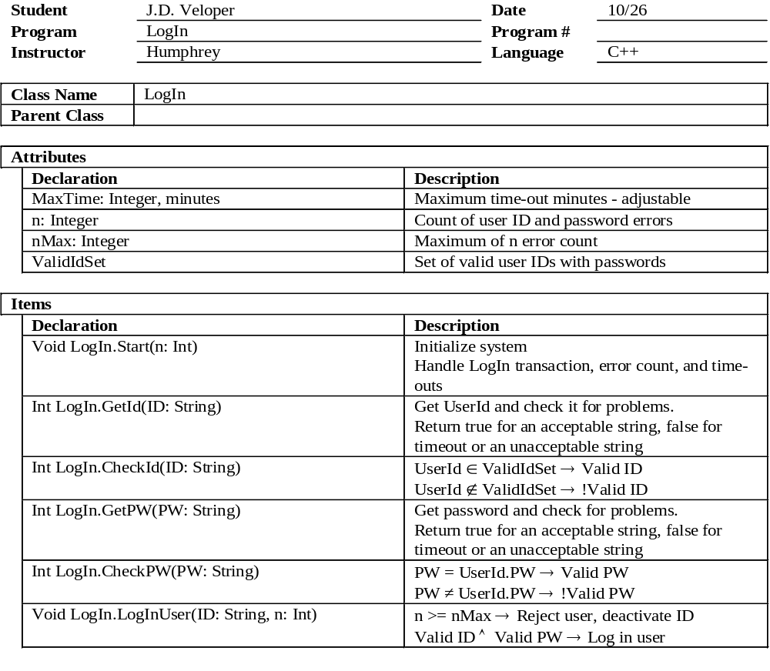
Example Functional Template

Slide 31
Producing the Functional Template
To produce a functional template, you must
  decide how to build the product
  define the product’s functions
  define the key product attributes
The functional specification is usually developed in steps.
  Produce an initial design.
  Refine the elements of that design.
  Revise the functional specification template as you better understand how to build the product.

Slide 32
Functional Template Class Exercise -1
For this exercise, as a class, we will produce a functional specification template for program 5.
We’ll start by quickly sketching out a design of program 5.

Slide 33
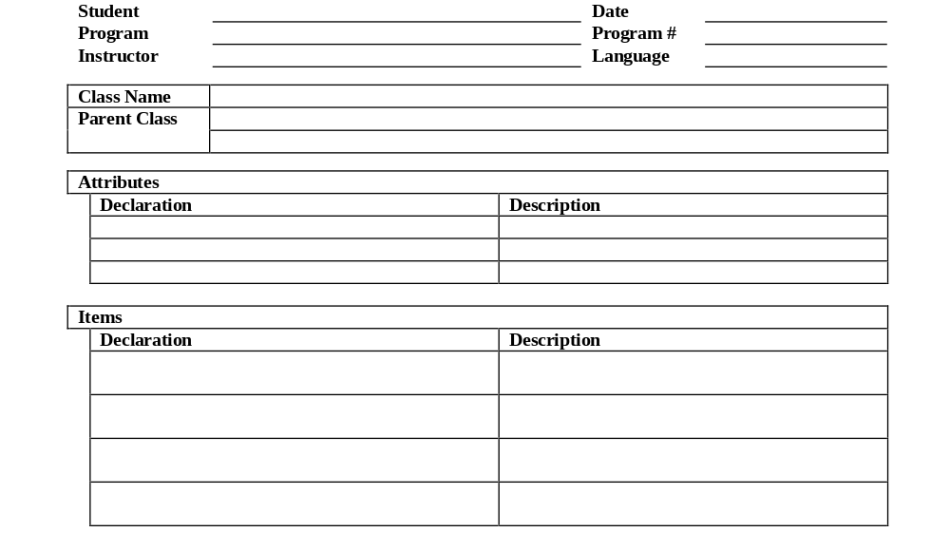
Functional Template Class Exercise -2
Next, we will produce a functional specification template for program 5.

Slide 34
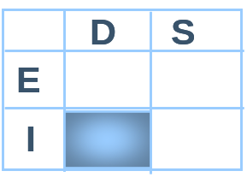
State Specification Template -1
The state specification template (SST) precisely defines
  the program states required
  transitions among the states
  actions taken with each transition
With the SST, you can
  define state machine structure
  analyze the state machine design
  recognize mistakes and omissions

Slide 35
State Specification Template -2
The SST specifies
  the name of every state
  a brief description of each state
  the name and description of any functions or parameters used in the SST
  the conditions that cause transitions from the state to itself or to any other state
  the conditions that cause transitions from any other state to this state
  the actions taken during each transition

Slide 36
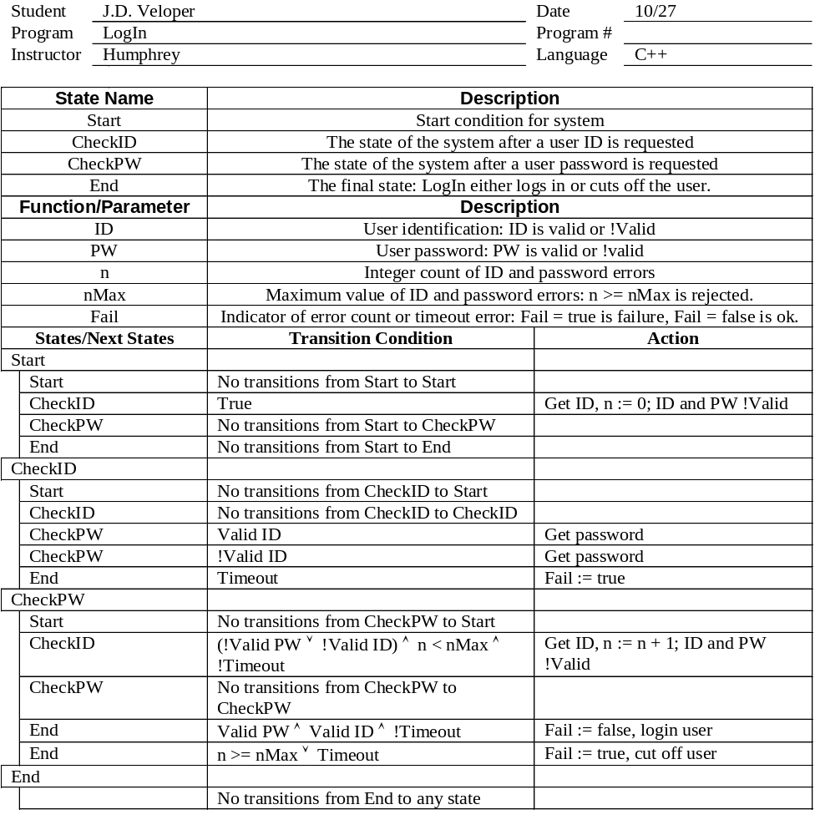
Example State Template

Slide 37
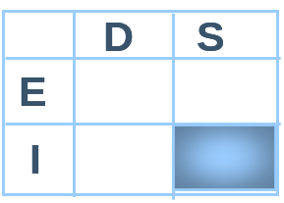
Logic Specification Template -1
The logic specification template precisely defines the program’s internal logic.
Its objective is to describe the logic in a concise and convenient notation.
  A pseudocode compatible with the implementation language is often appropriate.
  Formal notation is also appropriate.
  Both the designers and the implementers must be familiar with the notation used.

Slide 38
Logic Specification Template -2
The logic specification template should specify
  the logic for each item or method, each part and class, and the overall program
  the precise call to each program, part, or method
  any external references
  special data types and data definitions

Slide 39
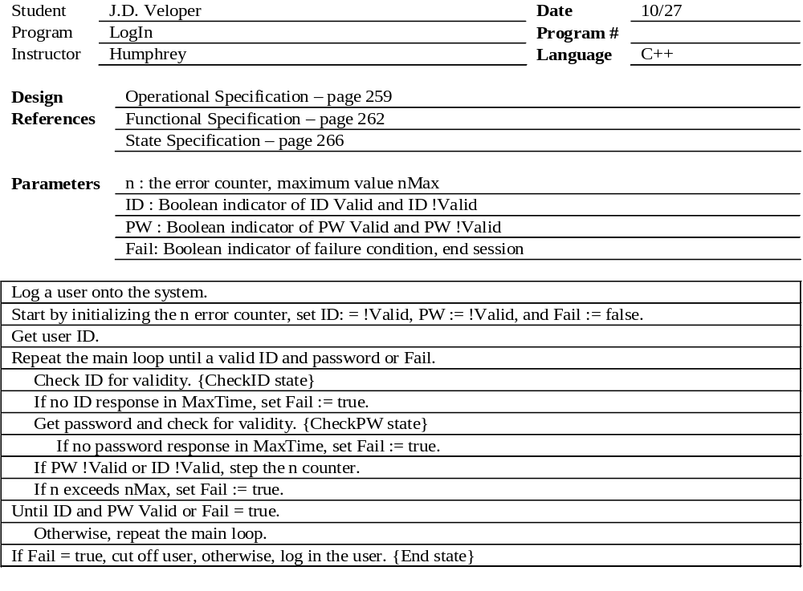
Example Logic Template

Slide 40
Using Pseudocode
In producing pseudocode designs
  use spoken language
  where possible, avoid programming constructs
  where unavoidable, use constructs from the implementation language
  where the program’s action is clear, make a brief note
  be more specific about complex constructs, loops, and state-machine structures
Consider writing the pseudocode in your development environment.
Later, when implementing the program, include the pseudocode in the comments.

Slide 41
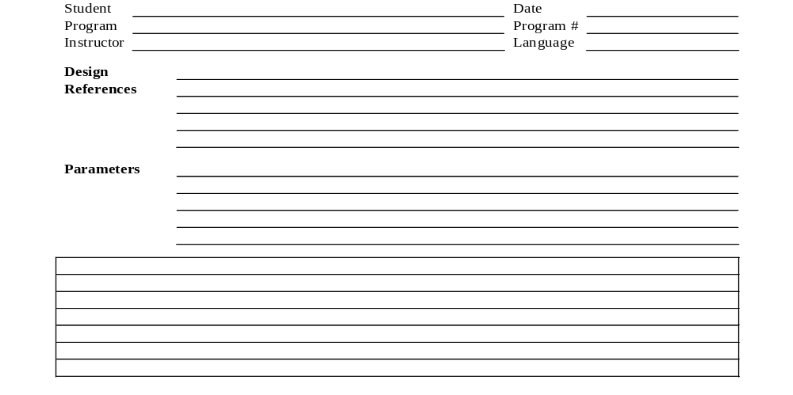
Logic Template Class Exercise -1
For this exercise, as a class, we will produce a logic specification template for a function in program 5.

Slide 42
Using Design Templates
The PSP design templates provide one way to represent a design.
  They are precise, unambiguous, non-redundant, and complete.
  Use the PSP design templates in conjunction with your other design methods.
Other representations may be substituted if they are equally precise, unambiguous, non-redundant, and complete.

Slide 43
Design Guidelines
When designing large programs, use a dynamic design strategy that allows for uncertainty.
Some design problems cannot be resolved without first building and testing a potential solution. For these cases, use prototyping.
When modifying or enhancing an existing system without a documented design, use the design templates to record the design as you decipher it.

Slide 44
The Design Hierarchy
You can use the design templates to refine the specification and design of large or small software products.
  system
  program
  component
  module
Starting with requirements, produce a set of design templates to describe the highest-level product.
Use these design templates as the requirements for producing the design templates for the next product level.

Slide 45
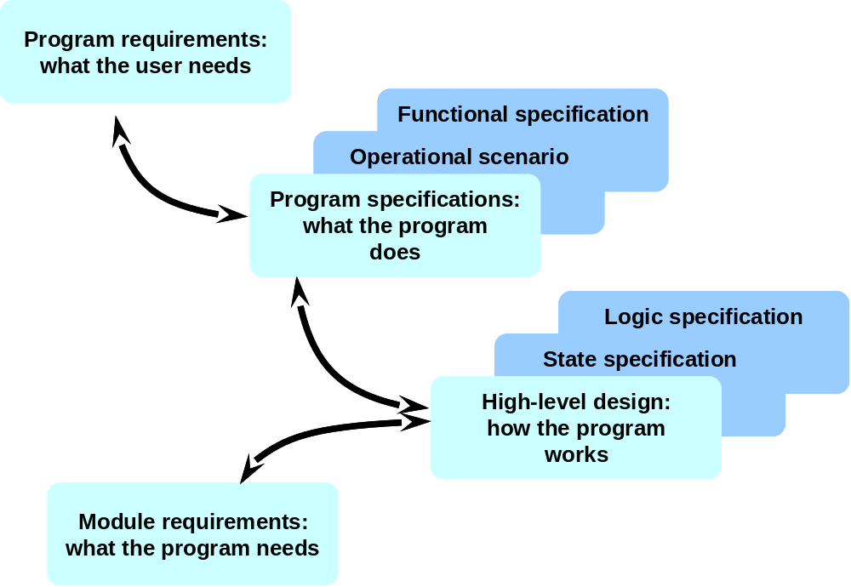
Program Design

Slide 46

Module Design

Slide 47
Messages to Remember
While design is a creative process, its routine aspects can be defined.
A good design notation will reduce design defects.
Using precise design specifications and formats will improve design quality.
Use the PSP design templates in the course exercises, and whenever you can do so in your work.

